Slide 1


[RESUME SORTER USING NLP]
KAJAL GARG , REKHA KUMAYAN
Under Supervision of
Internal : Dr. Tanu Gupta
School of Engineering and Technology
KAJAL GARG , REKHA KUMAYAN
Resume Sorter Using NLP
ENSI152
1 / 11

Slide 2
Introduction
Brief Overview:
This research focuses on developing and evaluating Natural Language Processing (NLP) techniques to automate the extraction and analysis of information from resumes.
With the increasing volume of job applications, traditional methods struggle to maintain efficiency and fairness.
Spending excessive time screening resumes manually.
Inconsistent evaluations due to subjective judgments.
Biases that may unintentionally exclude qualified candidates.
:
KAJAL GARG , REKHA KUMAYAN
Resume Sorter Using NLP
ENSI152
2 / 11

Slide 3
Objectives
Improve the accuracy of candidate-job matching by
leveraging advanced NLP techniques.
Streamline the recruitment process to save time and resources for organization.
Automate resume screening using NLP techniques.
KAJAL GARG , REKHA KUMAYAN
In8tRReseume Sorter Using NLP
ENSI152
3 / 11

Slide 4
Problem Statement
According to the research paper "Resume Screening with NLP"(2024) , Alphanumeric Journal.
Existing systems face challenges such as handling diverse resume formats, inconsistent terminologies, and poor semantic matching with job descriptions.
Scalability issues, biases in evaluation, and difficulties
integrating effectiveness processes
with recruitment platforms hinder the
and fairness of automated shortlisting
KAJAL GARG , REKHA KUMAYAN
[Resume Sorter Using NLP]
ENSI152
4 / 11

Slide 5
Methodology
Data Collection
Text Preprocessing
Feature
Extraction
Resume Classification
Train ML Model
Accuracy
our Name
KAJAL GARG , REKHA KUMAYAN
Resume Sorter Using NLP
ENSI152
5 / 11

Slide 6
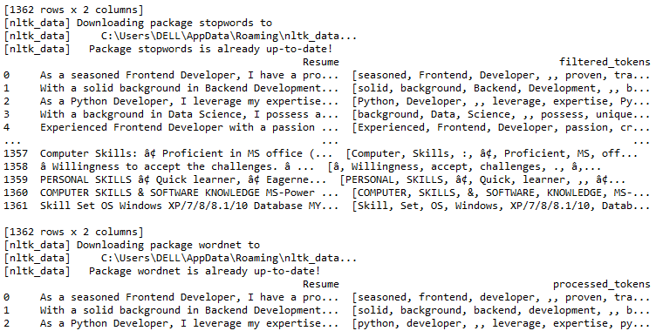
Output
our
KAJAL GARG , REKHA KUMAYAN
Resume Sorter Using NLP
ENSI152
6 / 11

Slide 7
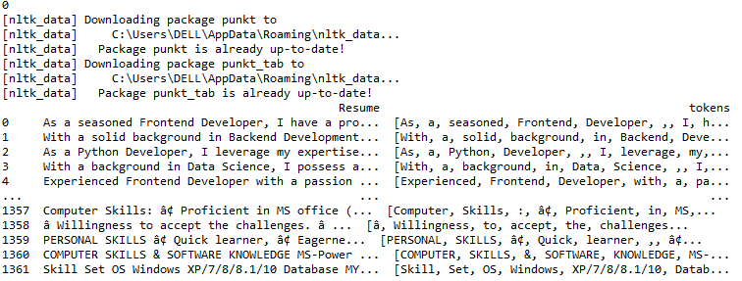

Slide 8
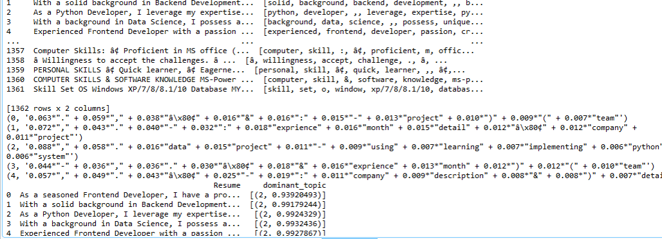

Slide 9
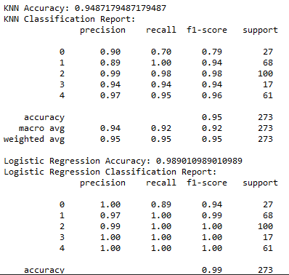
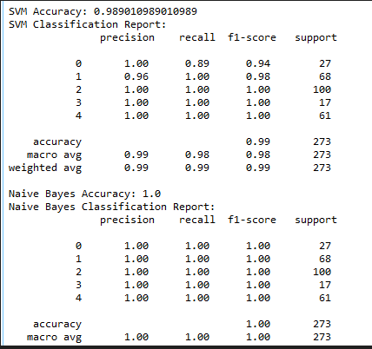
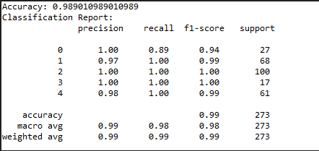
Output

Slide 10
Applications
Automated Resume Screening: NLP algorithms can
efficiently process and analyze large volumes of resumes.
Resume Ranking and Matching: By comparing the content of resumes with job descriptions.
Semantic Analysis: NLP enables the understanding of context and meaning within resumes.
Predictive Analytics: By analyzing historical hiring data,
NLP models can predict candidate success and performance.
Resume Parsing: NLP facilitates the extraction of structured data from unstructured resume formats.
KAJAL GARG , REKHA KUMAYAN
Resume Sorter Using NLP
ENSI152
7 / 11

Slide 11
Challenges and Limitations
Time-Consuming Process:
Reviewing each resume
individually takes a significant amount of time and effort.
Bias and Inconsistencies: Human recruiters may unintentionally exhibit biases based on factors like gender, age, or educational background. These biases can affect the fairness of the hiring process and lead to unbalanced candidate selection.
High Volume of Applications: With the rise of online job portals, companies receive a massive influx of resumes.
Quality of Matching: Identifying the most relevant candidates based on skills and qualifications is often challenging due to the variation in resume formats and the lack of standardization.
our
KAJAL GARG , REKHA KUMAYAN
Resume Sorter Using NLP
ENSI152
8 / 11

Slide 12
Conclusion
The motivation behind this project lies in creating a future-oriented solution that transforms traditional recruitment practices. By leveraging NLP, we aim to automate resume evaluation, ensuring faster and more accurate shortlisting of candidates.
.
This solution aligns with the evolving demands of modern organizations, which require scalable, unbiased, and technology- driven approaches to recruitment.
With increasing advancements in AI and NLP, this project offers a forward-thinking approach that not only addresses present challenges but also anticipates the needs of a rapidly changing job market.
our
:
KAJAL GARG , REKHA KUMAYAN
Resume Sorter Using NLP
ENSI152
9 / 11

Slide 13
References
Resume Screening With Natural Language Processing
(NLP)(2024), Alphanumeric Journal
Application of LLM Agents in Recruitment(2024) , A Novel Framework for Automated Resume Screening. Journal of Information Processing
Resume Ranking Using Natural Language Processing(2024), Journal of Computers and Intelligent Systems
Applicant Screening System Using NLP(2023), International Conference on Innovative Data Communication Technologies and Application .
our
KAJAL GARG , REKHA KUMAYAN
Resume Sorter Using NLP
ENSI152
10 / 11

Slide 14
THANK YOU…

